Slide 1
UVA Democracy Biennial
In 2021, University of Virginia’s Miller Center held a series of talks with civic leaders to discuss the future of Democracy - what our country needs in the short term to survive as a democracy, and the long term.
These leaders exemplify civic action in one way or another. They were chosen because of their amplified participation in civic life (which is a core feature of a democratic society)
Look through the speakers bios and decide what behaviors do you think they exhibit that make them model citizens? Add these to your “think pair share.”
Example: “I think an additional behavior or characteristic of good citizens is to care about the world, not just the US. We live in an interconnected world and we are citizens of the US and the globe. I see this in Carolyn Miles biography in particular.”

Slide 2
Ai Jen Poo | Tom Perez | Deborah Feinen
Rashad Robinson | Leaders in Civic Life | Larry Diamond
Angela Glover Blackwell | Rami Nashashibi | Carolyn Miles

Slide 3


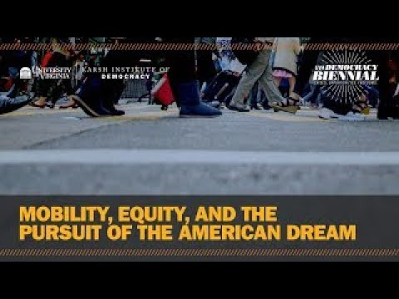
Ai-Jen Poo
“Domestic workers are poorly paid, lack benefits and economic security and are susceptible to discrimination and abuse.”
NDWA
Created a nonprofit to help domestic workers - many of whom are immigrants and women of color.
Successfully brought more than 2 million workers under minimum wage protections.
Helped pass a workers “Bill of Rights” in ten states.
Ai-jen Poo is the co-founder and Executive Director of the National Domestic Workers Alliance, a non-profit organization working to bring quality work, dignity and fairness to the growing numbers of workers who care and clean in our homes, the majority of whom are immigrants and women of color. In 12 short years, with the help of more than 70 local affiliate organizations and chapters and over 200,000 members, the National Domestic Workers Alliance has passed Domestic Worker Bills of Rights in 10 states and the 2 cities, and brought over 2 million home care workers under minimum wage protections.
Notes:
44:00 - 45:48

Slide 4


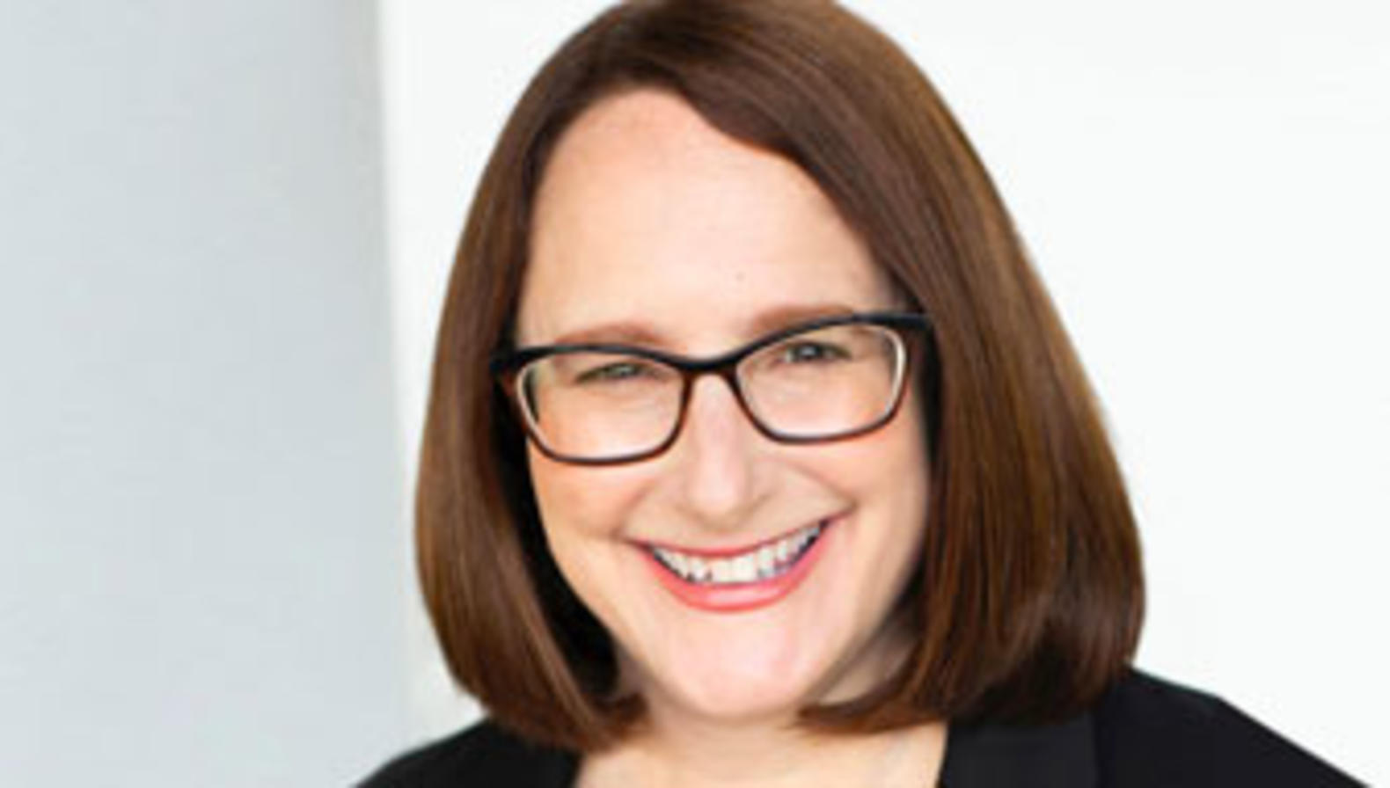
Deborah Feinen
Deborah Feinen is the Mayor of Champaign, Illinois (term ending 2023). Prior to being on the City Council, Deb served as a Champaign County Board member for fourteen years, including serving as the vice-Chair of the County Board. Deb was appointed to the Champaign City Council in 2006, as an At-Large representative. She was subsequently re-elected twice and was elected Mayor in 2015, and re-elected Mayor in 2019. Deb is passionate about making positive change in Champaign and among other things is an advocate for the City’s Goal Getters program, CU-Fresh Start, and the LIFT Champaign program
“Champaign is an inclusive community that welcomes all. City residents enjoy a great quality of life, first class educational opportunities, and easy mobility.”
Mission, City of Champaign, Ill
Mayor Feinen worked as an attorney for the public and private sectors.
She served in local government for over a decade, first as a county board member, then as a city council member.
Mayor Feinen was first elected in 2015 to be Mayor.

Slide 5
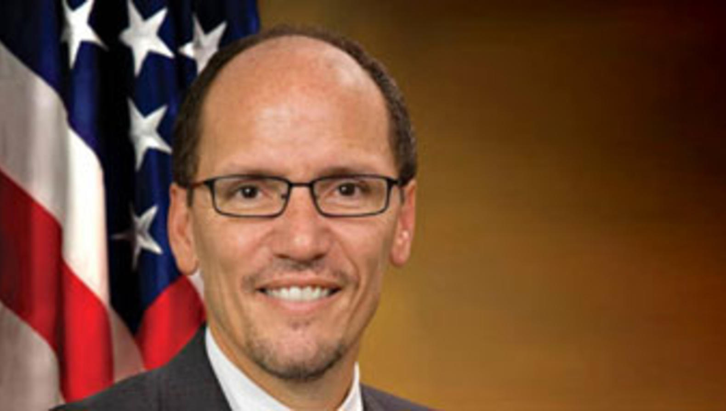
Tom Perez
Tom Perez served as the chair of the Democratic National Committee from 2017–21. He was previously United States secretary of labor and assistant attorney general for civil rights. For 8 years, Tom served in President Obama’s administration. First as head of the department’s Civil Rights Division, then as Secretary of Labor.
But Tom’s roots are in local organizing. In 2002, he became the first Latino elected to the Montgomery County Council. And as board president of CASA de Maryland, Tom helped grow the organization from a small service provider in the basement of a church to one of the largest immigrant advocacy groups in the mid-Atlantic.
Worked on the back of a garbage truck before becoming a civil rights attorney for the US Dept. of Justice.
While an attorney he prosecuted cases against police misconduct, voter suppression and anti-LGBTQ discrimination,
As Secretary of Labor he fought to protect and expand opportunities for America’s working people – from better wages and overtime pay, to retirement security and collective bargaining rights.

Slide 6
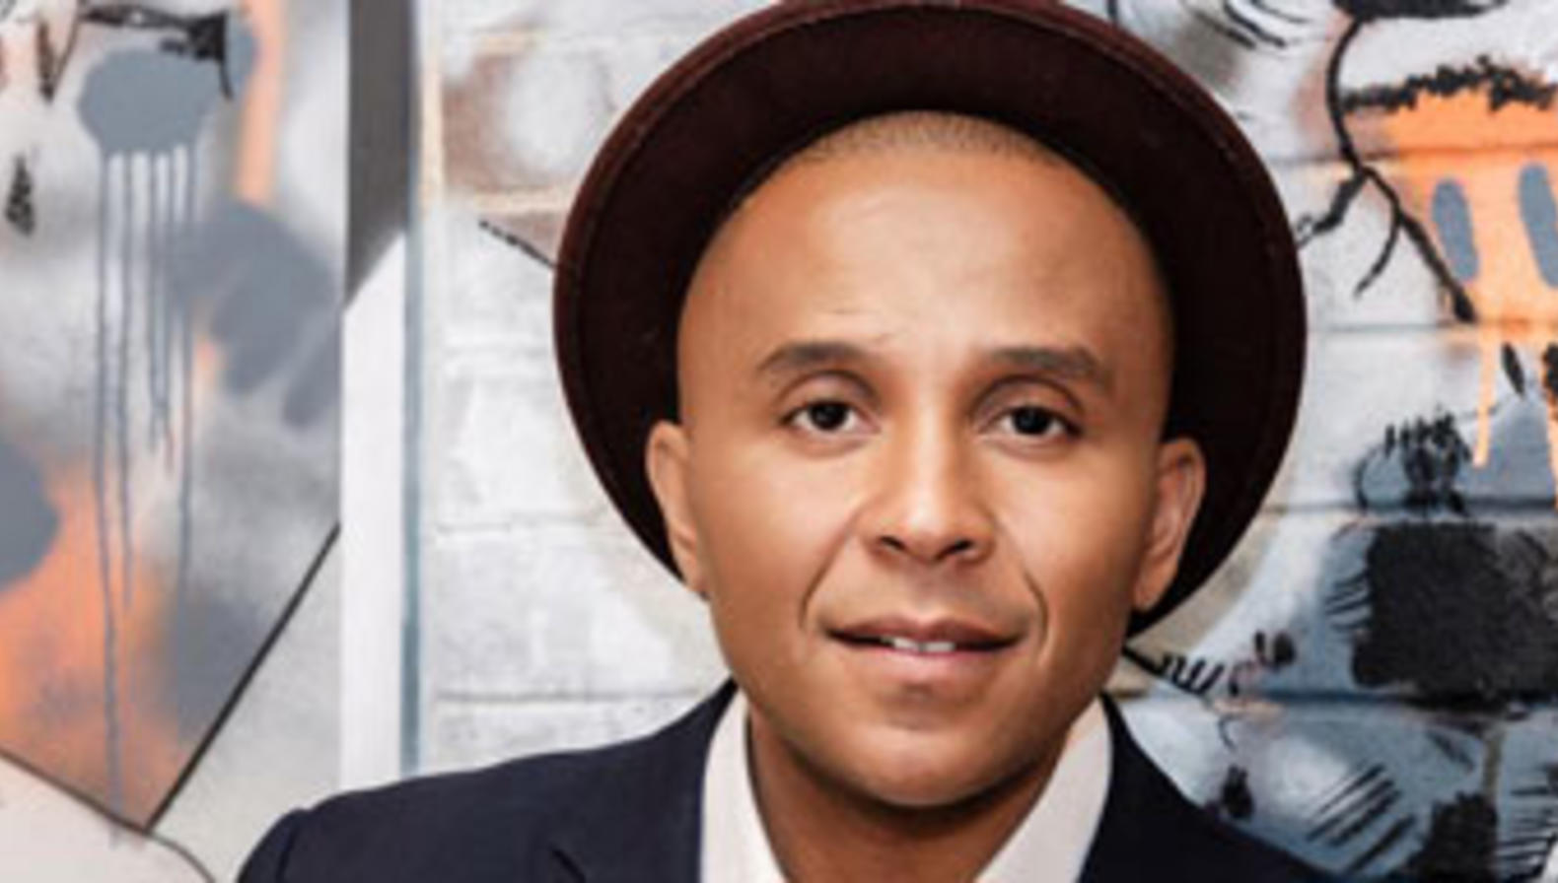
Rashad Robinson
“Color Of Change is the nation’s largest online racial justice organization. We help people respond effectively to injustice in the world around us. As a national online force driven by 7 million members, we move decision-makers in corporations and government to create a more human and less hostile world for Black people in America.”
Color of Change Mission
Rashad Robinson has been the president of Color of Change since 2011 and serves on the board of the Hazen Foundation, Demos, and the National LGBTQ Taskforce. Color Of Change uses innovative strategies to bring about system change in the industries that affect Black people’s lives: Silicon Valley, Wall Street, Hollywood, Washington, corporate board rooms, local prosecutor offices, state capitol buildings and city halls around the country. Under Rashad’s leadership, Color Of Change designs and implements winning strategies for racial justice. Rashad is widely consulted on strategies for corporate accountability, transforming the criminal justice system, media and tech reform, culture change and narrative infrastructure, and building Black political power.
Notes:
17:34 - 18:57

Slide 7
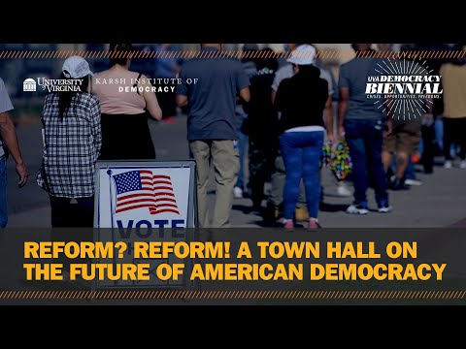
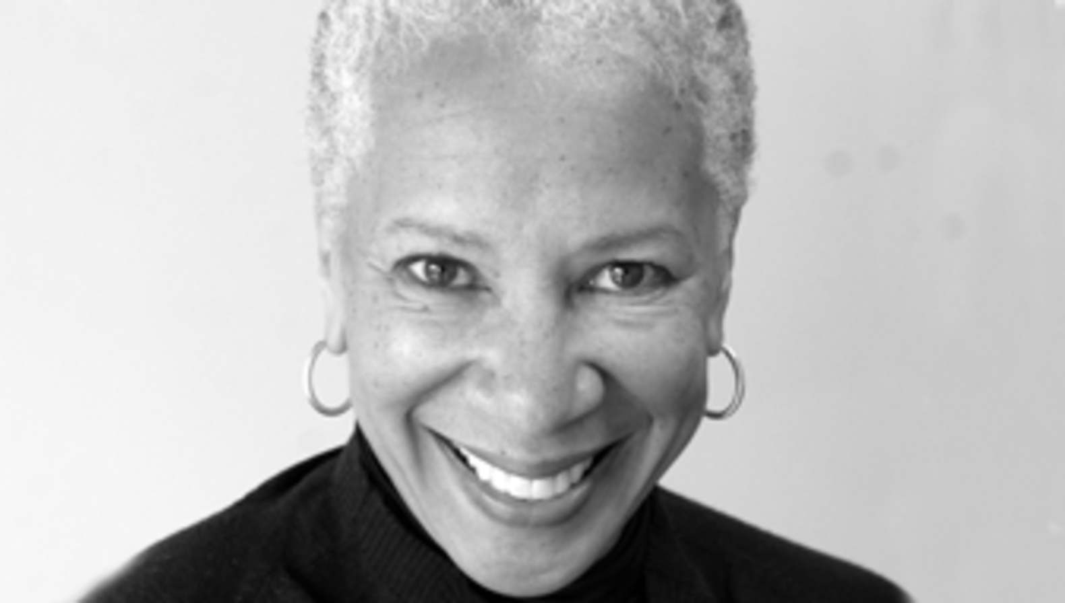
Angela Glover Blackwell
Prior to founding PolicyLink, she served as Senior Vice President at The Rockefeller Foundation.
She is a lawyer and published author.
She advised the Board of Governors of the Federal Reserve as one of 15 members of its inaugural Community Advisory Council, and in 2020 was appointed by California Governor Gavin Newsom to the state Task Force on Business and Jobs Recovery.
Angela Glover Blackwell is founder in residence at PolicyLink, the organization she started in 1999 to advance racial and economic equity for all. Under Angela’s leadership, PolicyLink gained national prominence in the movement to use public policy to improve access and opportunity for all low-income people and communities of color, particularly in the areas of health, housing, transportation, and infrastructure. Angela is also the host of the Radical Imagination podcast and Professor of Practice at the Goldman School of Public Policy, University of California, Berkeley.

Slide 8
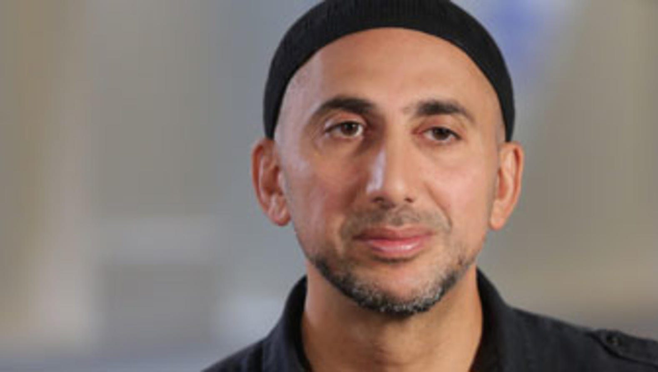
Rami Nashashibi
“The Inner-City Muslim Action Network (IMAN) is a community organization that fosters health, wellness and healing in the inner-city by organizing for social change, cultivating the arts, and operating a holistic health center.”
About Us, IMAN Website
Dr. Rami Nashashibi is a MacArthur Fellow, a Doctor of Sociology from the University of Chicago, and the founder and Executive Director of the Inner-City Muslim Action Network (IMAN), a non-profit organization incorporated in 1997 that fosters health, wellness and healing on Chicago’s South Side & Atlanta’s west end by organizing for social change, cultivating the arts and operating a holistic health center. As a community leader building bridges across racial, religious, and socioeconomic divides to confront the challenges of poverty and disinvestment in urban communities, Rami has successfully unified a diverse set of constituencies around a shared focus of social justice.

Slide 9
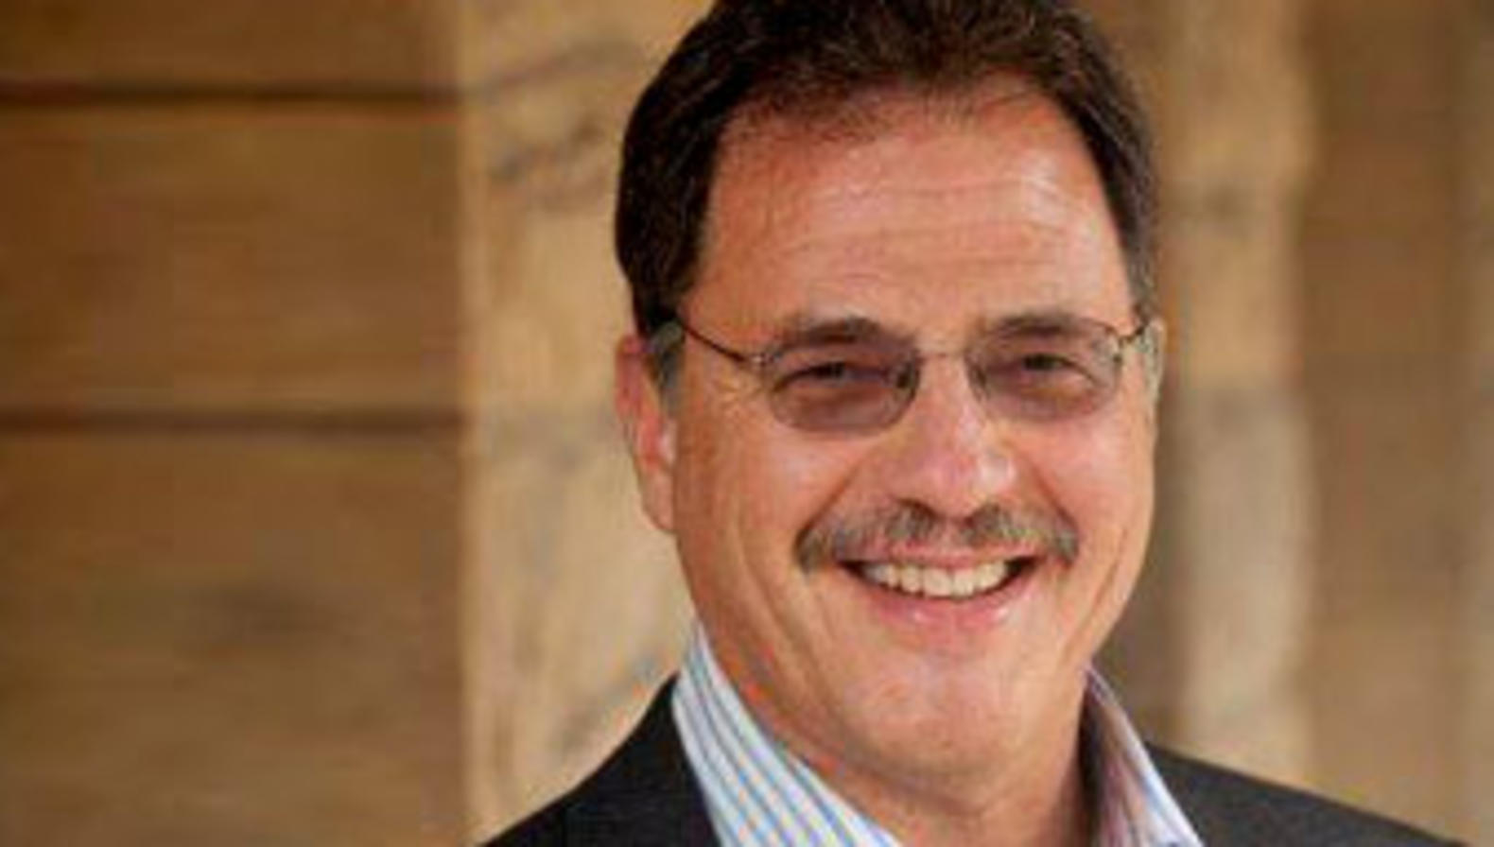
Larry Diamond
Larry Diamond is a senior fellow at the Hoover Institution and at the Freeman Spogli Institute for International Studies (FSI) and a Bass University Fellow in Undergraduate Education at Stanford University. He is also professor, by courtesy, of political science and sociology at Stanford. He leads the Hoover Institution’s programs on China’s Global Sharp Power and on Taiwan in the Indo-Pacific Region. At FSI, he leads the Program on Arab Reform and Democracy, based at the Center on Democracy, Development, and the Rule of Law, which he directed for more than six years. He also coleads (with Eileen Donahoe) the Global Digital Policy Incubator based at FSI’s Cyber Policy Center.
Expert in government, policy and democracy
He has written numerous books on the state of democracy, including:
  Ill Winds: Saving Democracy from Russian Rage, Chinese Ambition, and American Complacency
  In Search of Democracy (2016), The Spirit of Democracy (2008), Developing Democracy: Toward Consolidation (1999), Promoting Democracy in the 1990s (1995), and Class, Ethnicity, and Democracy in Nigeria (1989)

Slide 10
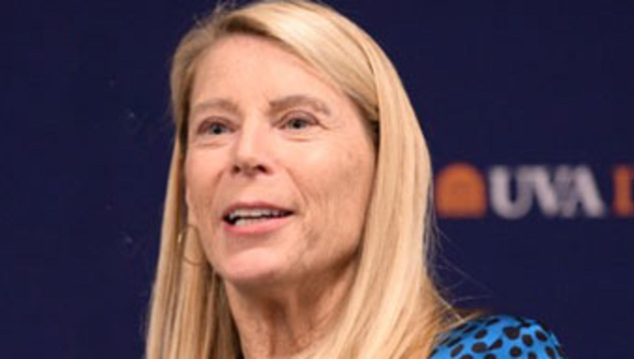
Carolyn Miles
Carolyn Miles is Former President & Chief Executive Officer of Save the Children, an organization that gives children in the United States and around the world a healthy start, the opportunity to learn and protection from harm. The global Save the Children movement currently serves over 185 million children in the US and in more than 120 countries. As a global organization, Save the Children has committed to driving down the numbers of preventable deaths of children under 5, ensuring every child gets a high-quality basic education and protecting all children from harm.
“Save the Children was the first global movement for children, boldly declaring that children have rights.
Today, we champion the rights of the world’s 2.3 billion children.”
Save the Children Website

